Slide 1
Unit I Introduction

Slide 2
Hacking Impacts
Hacking is computer crime that can result in massive financial losses for companies, governments, and individuals.
The costs associated with computer crime can range from clear hit to the bottom line.
Digital assets where costs from hackers can manifest themselves fall into four major categories:
Resources,
Information,
Time, and
Reputation.

Slide 3
Hacking Impacts-cont..
Resources.
Resources are computer-related services that perform actions or tasks on the user’s behalf.
Core services, object code, or disk space can be considered resources that, if controlled, utilized, or disabled by an unauthorized entity, could result in the inability to capture revenue for a company or failure to meet expected objectives.
Information.
Information can represent an enormous cost if destroyed or altered without authorization.
Data can be affected in several ways such as: loss, disclosure, and integrity.

Slide 4
Hacking Impacts-cont..
Time.
The loss of time can be related to costs in the form of payroll, not meeting critical deadlines, or an unavailable E-commerce site that would normally produce thousands of dollars in revenue if it were available.
Anything that consumes time, consumes money, and expenditures for recovering from an incident can represent the greatest form of financial loss.
Brand and Reputation.
There are many companies who have very recognizable brands, like color alone will promote images.

Slide 5
The Hacker
First of all, the term “hacker,” historically speaking, is inaccurate. In the early days of computing a hacker was someone who investigated the workings of computers for fun and a challenge.
Cracker was a term used to identify people who would break computers to use them for free or use system resources.
Somewhere between the Internet revolution and the movies, hacker was adopted to describe computer criminals.

Slide 6
TYPE OF HACKER
Here are several types of hackers, but we can reduce this to three basic characteristics that we can use to categorize the enemy:
Script kiddies
Hackers
Über hacker
Script kiddies
“Script kiddie” refers to a hacker who influences tools created by other, more knowledgeable hackers to perform malicious acts.
There are several degrees of damage that can be caused by people who fall into this category.
Script kiddies can be grouped into three areas: unstructured, structured, and determined.

Slide 7
TYPE OF HACKER-Cont…
Hackers
Hackers are the next step in the evolution of an attacker and make up the majority of the people.
Hackers explore computers for education, the challenge, and to achieve a social status among other hackers.
There are four distinguishing faculties of the hacker: malicious, solvers, hacktivist, and vigilante.
Malicious.
Malicious hackers are people with the sole intent of causing damage, destruction, or disruption of information systems.
Writers of malware fall directly into this category, as do people who gain access to sites and corrupt information.

Slide 8
TYPE OF HACKER-Cont…
Solvers.
There are hackers that gain access to systems to solve a problem.
Many of these attacks are based on changing or removing information to rectify a situation.
Hacktivist.
There are several hacking communities that band together for a common cause.
Vigilantism.
One aspect of hacking that you do not see on the news and in the daily paper is the vigilante groups that surreptitiously attack the Internet’s lower lifeforms, to use their terms.

Slide 9
TYPE OF HACKER-Cont…
über hacker
In German, über can be loosely translated to “super.”
The resulting definition is easy to interpret: “Super Hacker.”
An über hacker is a person with exceptional skills, fortitude, and a long list of experiences to draw upon for future hacks.
These are the elite and nearly unstoppable hackers.
To be an über hacker you must have exceptional skills in programming, logic, systems, operating systems, applications, hardware, communications, and protocols along with a strong dose of attitude and unethical behavior.

Slide 10
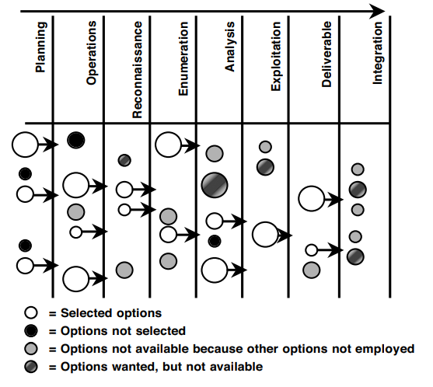
Framework

Slide 11
Planning the test
Planning describes many of the details and their role in formulating a controlled attack.
Security policies, program, posture, and ultimately risk all play a part in guiding the outcome of a test.
What drives a company’s focus on security, its core business needs, challenges, and expectations will set the stage for the entire engagement.

Slide 12
Sound Operations
How is the test going to be supported and controlled?
What are the underlying actions that must be performed regardless of the scope of the test?
Who does what, when, where, how long, who is out of bounds, and what is in bounds of a test all need to be addressed.
Logistics of the test will drive how information is shared and to what degree (or depth) each characteristic will be performed to achieve the desired results.
Operational features will include determining what the imposed limitations of the tester are and how they are evaluated during the test.

Slide 13
Reconnaissance
Reconnaissance is the search for freely available information to assist in the attack.
The search can be quick ping sweeps to see what IP addresses on a network will respond.
Reconnaissance can include theft, lying to people, tapping phones and networks, impersonations, or even leveraging falsified friendships to collect data about a target.

Slide 14
Enumeration
Enumeration (also known as network or vulnerability discovery) is essentially obtaining readily available (and sometimes provided) information directly from the target’s systems, applications, and networks.
An interesting point to make very early is that the enumeration phase represents a point within the project where the line between a passive attack and an active attack begins to blur.
TCP/IP uses a basic session setup.
More technically, the TCP protocol has what is commonly known as the “three-way handshake” that is used to start TCP connections:
Computer A sends a message called a “SYN” (Synchronize) to Computer B.
Computer B acknowledges that message with a “SYN+ACK” (SYN with an Acknowledgement) to Computer A.
Computer A sends back an acknowledgement—“ACK.”

Slide 15
Vulnerability Analysis
There is a logical and pragmatic approach to analyzing data.
During the enumeration phase, we try to perform an interpretation of the information collected looking for relationships that may lead to exposures that can be exploited.
The vulnerability analysis phase is a practical process of comparing the collected information with known vulnerabilities.

Slide 16
Exploitation
A great deal of planning and evaluation is being performed during the earlier phases to ensure a business-centric foundation of value is established for the test.
The attack process is broken up into threads and groups and each appears in sets of security.
A thread is a collection of tasks that must be performed in a specific order to achieve a goal.
Threads can be one step or many in a series used to gain access.
Each divergence from the plan is appraised to make two fundamental determinations:

Slide 17
Exploitation-Cont…
Expectations.
Are the expectations of the thread or group not being met or are the test’s results conflicting with the company’s assumptions?
The objective is to ensure each test is within the bounds of what was established and agreed upon
Technical.
Keeping your eyes open for unexpected responses from systems ensures you have not negatively affected the target or gone beyond the set scope of the test.

Slide 18
Final Analysis
Although the attack process has many checks and validations to ensure the overall success of the engagement, a final analysis of all the collected data and exploits must be performed.
The first goal of the analysis is to take a comprehensive view of the entire engagement and look for other opportunities that may exist, but are not directly observed.
The final analysis is part interpretation and part empirical results.
To define something as critical with little evidence can become problematic when presented to the recipient of the test

Slide 19
Deliverable
Throughout the history of penetration testing there have been deliverables communicating the results of the test in numerous ways.
Some are short, only listing the identified vulnerabilities and where to find the patch to fix them.
Others are cookie cutter reports from tools that simply state which port was open, the vulnerability it represents, and where to find the patch.
There are some that detail every move made by the consultant: Cracked the passwords, and took over your shipping application and of course where to find the patch.

Slide 20
Deliverable-Cont…
Are these examples of poor deliverables? In reality, no.
In addition, ethical hacking has become so common that if a deliverable doesn’t drive fear into the hearts of the executives it could be considered a failure.

Slide 21
Integration
The deliverable communicates all the necessary information needed to actually support some form of integration.
The deliverable can be combined with existing materials, such as a risk analysis, security policy, previous test results, and information associated with a security program to enhance mitigation.
There are three distinguishing factors that should be considered during the integration of any test results:
Mitigation.
Defense
3. Incident Management.

Slide 22
Integration – cont…
Mitigation.
If something were found that represented a threat to secure operations and was beyond acceptable risk, then it would need to be fixed, to put it bluntly.
Of course, there are the easy things to rectify and there are very complicated solutions to seemingly simple problems.
Mitigation of a vulnerability can include testing, piloting, implementing, and validating changes to systems
Defense.
How should you address the insecurities in a strategic manner?
What about your networks, systems, applications, and policies that need to be addressed to ensure sound practices are employed to minimize the impact of future or undetected vulnerabilities?
Defense planning is establishing a foundation of security to grow on and ensure long-term success.

Slide 23
Integration – cont…
Incident Management.
Arguably, the core element of security—the ability to detect, respond, and recover from an attack—is an essential part of any security program.
Knowing how you were attacked, the vulnerabilities exploited, and the potential impacts aids in formulating an incident response plan.
The test provides an opportunity for you to learn about the various weaknesses and attractive avenues of attack.
Finally, you get an understanding of critical points in the network that may need more attention than others, and this may not be the perimeter as normally assumed.

Slide 24
Information Security Models
Information security has heard the term “defense-in-depth,” the practice of building many layers of security into systems, networks, Security and applications.
Defense-in-depth is creating several controls that are unique, but complement each other to provide effective protection.
The defense-in-depth model is defined in four layers:
1. Computer security
2. Network security
3. Service security
4. Application security

Slide 25
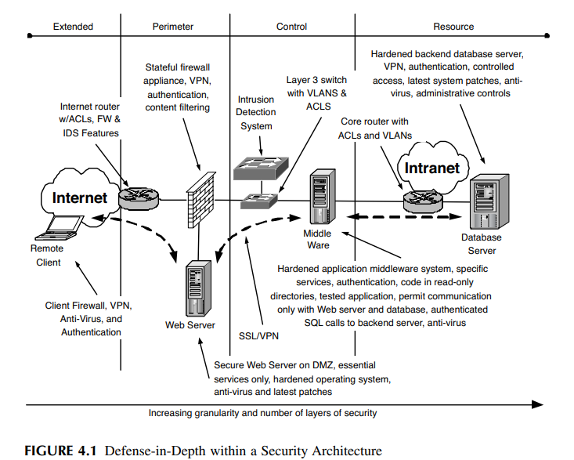
Information Security Models – cont…
These models are combined and demonstrated in the following figure.

Slide 26
Information Security Models – cont…
Computer Security
Computer security includes many diverse subjects, such as controlling authorized (and unauthorized) access, managing user accounts and their privileges, software management, change control, development, and database security, to mention a few.
Much of the security is afforded by the operating system responsible for providing the interface between the hardware and the software and ultimately the user.
Operating systems come in many types and flavors.
Microsoft’s Windows is the most prevalent operating system used today for home and business.
UNIX, an operating system born in Bell Labs, has many flavors and versions, such as Linux, BSD, Solaris, and AIX, to name a few of the popular ones.

Slide 27
Information Security Models – cont…
Computer security, better yet the lack of, could be considered the flashpoint for the birth of the common hacker.
The pains we’re experiencing today, the constant focus on the perimeter as the primary security provider, the explosion of viruses and worms, and the constant battle of integrity and reliability, all stem from the poor evolution of computer security.
Operating system security will not solve world hunger, but a secure system allows greater investment in access controls, comprehensive network security, and application security with less focus on viruses and small holes that lead to big results.

Slide 28
Information Security Models – cont…
HARDEN A SYSTEM Determining what steps are necessary to harden a system can be very frustrating.
There are numerous sources of various tactics for securing a system. There are sample configurations and tools that can be used to configure Microsoft and UNIX systems.
The following are some common characteristics of hardening a system.
Physically Secure It
Installing the Operating System
Get It Running
Get It Running
Cleanup
There are three types of patches:
1. Functionality. A patch that fixes or enhances a certain function of the system. For example, how memory is handled, performance of network connections, or adding more options to an administrative program.
2. Feature. A feature patch increases the use of the system, an added feature.
3. Security. A security patch fixes a vulnerability in the system due to unexpected conditions the system is in or a misstep in programming.

Slide 29
Information Security Models – cont…
Network Security
Networks are relatively simple.
When a computer wishes to establish communications with another it generates a message augmented with a header, containing logistical information about the source and destination, and the entire package is called a packet.

Slide 30
Information Security Models – cont…
As with computer security, there are various characteristics of network security. These are summarized in the following list:
• Transmission Security: The protection of data as it is transmitted from one location to another.
• Protocol Security: The construction of packets and how they are processed and used to transmit information.
• Routing Protocol Security: The information that is shared by network devices to work together to support communications.
• Network Access Security: Controlling connectivity from one network to another based on protocol specifics.

Slide 31
Information Security Models – cont…
TRANSMISSION SECURITY
One aspect of network security is the protection of information in transit.
Ensuring sensitive data is protected from unauthorized changes or viewed by unauthorized people (or applications) is an important aspect of secure network communications.
Security protocols, such as IPSec (Internet Protocol Security), SSL (Secure Sockets Layer), and SSH (Secure Shell) to name a few, provide authentication and encryption to protect information from unwanted interactions.
There are also protocols that usually work in cleartext.
File Transfer Protocol (FTP) and Telnet are interactive sessions between systems that are not provided any protection to keep the commands and passwords private.

Slide 32
Information Security Models – cont…
PROTOCOL SECURITY
Another characteristic of network security is the protocols that are used to support the communication.
Transmission Control Protocol and Internet Protocol (TCP/IP) is the most common protocol used today and is the protocol for use on the Internet.
A protocol is the standard by which a communication is established.
There are many protocol weaknesses that are associated with TCP/IP.
By using illegal packet structures and manipulating the session management the protocol provides, several types of attacks can materialize.
Other weaknesses in the protocol allowed one system to appear as another.
This was an especially effective attack when security was based on assumed trust relationships based on an IP address, the unique identifier of a system on a TCP/IP network.
Second, because the hacker is not receiving the acknowledgments, he must respond in the appropriate timeframe with all the correct information expected by a normal session.

Slide 33
Information Security Models – cont…
ROUTING PROTOCOL SECURITY
Routing protocols are specific communications between network supporting systems that allow the sharing of network information so a group of devices can collaborate on appropriately forwarding data.
When routing data is shared among a group of systems communications can be routed based on network availability, performance, and cost of the connection.
Figure (next slide) is an example of a large network supported by the OSPF (Open Shortest Path First) routing protocol. OSPF uses “areas” to define borders for summarizing network routes to different regions, as with this example, or departments.

Slide 34
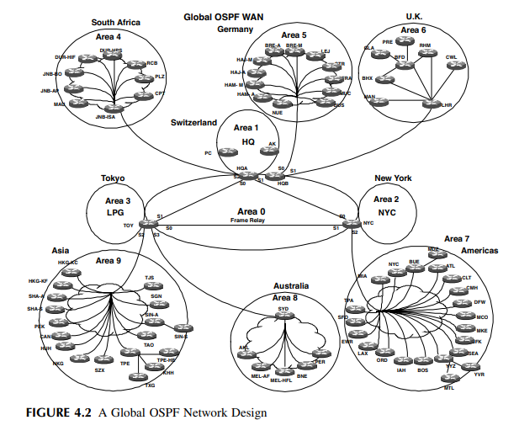

Slide 35
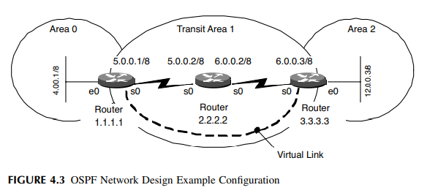

Slide 36
Information Security Models – cont…
NETWORK ACCESS CONTROLS
Network security can also be characterized by applying access controls, limiting the availability of communications between systems or applications.
In TCP/IP headers there are collections of bits that identify specifics about the communication.
Application ports are an example of this type of information.
The port is a number from 1 to 65535 that identifies the services associated with the communication.
Application ports allow systems to accept packets destined for specific services or applications.

Slide 37
Information Security Models – cont…
Service Security
Services are processes that run on a computer to provide common functions for applications, users, or other services. Services fall into two very similar categories:
1. Operational. A process that provides a service to applications or users for functionality.
2. Network. A process that supports the exchange of information for network services.

Slide 38
Information Security Models – cont…
The following are examples of operational services used in Microsoft Windows:
• Security Accounts Manager. Stores security information for local user accounts.
• Plug and Play. Enables a computer to recognize and adapt to hardware changes with little or no user input.
• Net Logon. Supports pass-through authentication of account logon events for computers in a domain.
• Event Log. Enables event log messages issued by Windows-based programs and components to be viewed in Event Viewer. This service cannot be stopped.
Regardless of type, each service is an opportunity to attack a system.
Potential vulnerabilities in how services interact with a network, applications, and other parts of the operating system make them the focus of hackers.

Slide 39
Information Security Models – cont…
Application security
As we climb up the layers of security, applications represent the last step.
An application, especially software, is a collection of libraries, executables, and other utilities used to accomplish a wide variety of tasks.
Applications can come with their own forms of vulnerabilities and weaknesses that could be used by a hacker.
Some of these are benign from the perspective of the Internet because they require complete access to the system.

Slide 40
Information Security Models – cont…
Software introduces its own set of security concerns.
Applications can have errors, better known as bugs, which can not only disrupt operations but can provide a hole through which a hacker can crawl.
A software error can lead to massive failures such as implementing a rare configuration that exposes a bug in the software.
There are ample examples of these types of vulnerabilities that can be used by a hacker in many ways. Following are a few examples:
Exchange Server 2000 System Attendant gives the “Everyone” group privileges to the WinReg key, which could allow remote attackers to read or modify registry keys.
• Internet Explorer 5.01, 5.5, and 6.0 allow remote attackers to read files on a remote system via malformed requests to the GetObject function, which bypasses some of GetObject’s security checks.

Slide 41
Information Security Models – cont…
When executed correctly, code reviews will uncover many straightforward but dangerous security violations, such as:
• Buffer overflows
• Race conditions
• Tainted input
• Format string issues
• Trust management
• Third-party package connectivity
• Input validation
• Temporary file or memory usage
• Poor cryptography
• Appropriate logging and auditing

Slide 42
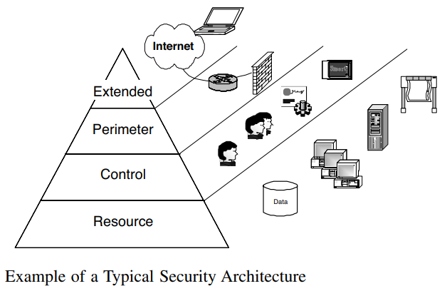
Security Architecture

Slide 43
Security Architecture
Commonalities among many of the architectures that are available are four layers that can be identified to promote sound security integration and management of technology, information, and policy:
1. The resource layer is where services and data reside. It is the home of servers, applications, databases, workstations, and storage.
2. One of the more critical and complex is the control layer, which provides identity and access management services. Moreover, the control layer is the point where policy becomes reality in the technical space. It provides management with the policy and is the point where policy is bound to data to promote greater authorization across the other characteristics of the entire security architecture.
3. There is the perimeter layer, which enforces a logical boundary between the Internet and the intranet, departments, applications, and even users.
4. Finally, the extended layer is a growing entity in its own right. This represents the externally facing envelope of influence and security, such as remote access risks, application access, and E-commercelity in the technical space. It provides

Slide 44
RESOURCE LAYER
Resources, as previously defined, are systems, applications, internal users, databases, services, printers, local area networks, operating systems, and data.
Resources represent what organizations feel are their core technical requirements to make money, or supporting mechanisms for the evolution of the business as a whole.
Nevertheless, resources are effectively what you want to protect, control access to, and use to conduct business.
In that light, not every resource demands the same level of security. It is not uncommon to have useful information destroyed with little or no impact on the business operations.
On the other hand, the slightest unauthorized change or loss of a specific piece of information can be catastrophic.

Slide 45
CONTROL LAYER
The control layer is an opportunity to identify and group systems that manage access to resources.
In a perfect world all identification, authentication, and authorization to resources would be controlled by a single system.
Thanks to legacy systems, different application architectures, and different approaches to applying security controls, the control layer is typically made up of many diverse products.

Slide 46
PERIMETER
Perimeter security is the most obvious layer in the security model.
Basically, it’s where your network stops and someone else’s begins.
It can be your connection to the Internet, the segregation of certain system types, or business units with different security needs.
Suffice it to say, the perimeter is usually easily identifiable.
The perimeter is much more than a firewall and there are other technologies that promote secure communications between trusted and not-so-trusted networks.
Intrusion detection and, most recently, intrusion prevention systems have provided another layer of security for the perimeter.

Slide 47
EXTENDED
The extended layer is how corporate security is projected out into the ether.
The most basic example is customers going to Web sites that have a security policy defining how information collected from online transactions is used.
Roaming users are another example of how corporate security influences information protection beyond the perimeter.
Organizations are concerned with the security of their intellectual property, brand name, and various information assets that are accessed and shared in many ways with varying types of users.

Slide 48
Information Security Program
A security program is concerned with preserving the confidentiality, integrity, and availability of an organization’s information assets and information should be considered an asset in whatever form.
This is a “big picture” approach to enhance the breadth of risk analysis, requiring a multidisciplinary look at risk identification.
Ethical hacking is testing security through the act of exploitation, the exploitation of anything that is assumed to provide a layer of control protecting resources, information, or other forms of assets.
A security program defines the necessary characteristics to ensure each layer of security is working in accordance with expectations, in addition to ensuring continuity of security from one layer to another

Slide 49
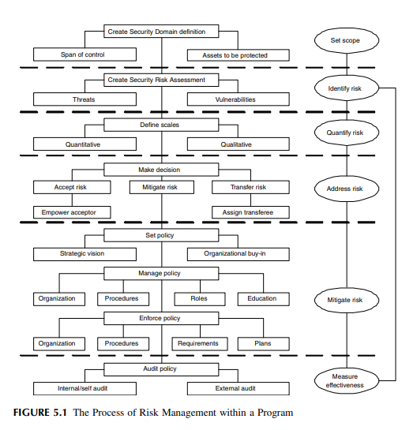
The Process of Information Security

Slide 50
Component Parts of Information Security Program
RISK ASSESSMENT
MANAGEMENT SYSTEM
CONTROLS
MAINTENANCE PLAN

Slide 51
Component Parts of Information Security Program – Cont…
RISK ASSESSMENT
An information security risk assessment identifies and quantifies risk, thus serving as the basis for addressing risk.
The risk assessment process requires creation of an initial security domain definition to set the scope of the assessment by acknowledging the span of control and relevant assets.
This corresponds to the security architecture model by defining physical and logical boundaries and tabulating assets at risk.

Slide 52
Component Parts of Information Security Program – Cont…
MANAGEMENT SYSTEM
Functional Roles allow assignment of specific security responsibilities such as Information Security Officers.
• Information Security Management Committees are chartered with specific tasks such as Configuration Control Boards.
• Multidisciplinary Management Forums are tasked with promoting information security awareness throughout the organization with codified practices that refine an organization’s risk mitigation strategy to a level of granularity that can be implemented.
• Policies express conceptual goals of upper management defining the risk mitigation strategy.
• Standards define measurable requirements in support of policy goals.
• Guidelines offer best practice advice on how to meet standard requirements.
• Procedures furnish step-by-step instructions to create a consistent and repeatable process.

Slide 53
Component Parts of Information Security Program – Cont…
CONTROLS
Controls come in many forms, including physical devices, configurations, roles, and processes, affecting networks, platforms, roles, and operations.
Many controls require subordinate or supporting controls. For example:
• A firewall is a network control device used to enforce network access and service requirements.
The firewall requires: – A supporting procedure for authorized users and services – A supporting role to administer the device – A supporting organization for configuration control

Slide 54
Component Parts of Information Security Program – Cont…
MAINTENANCE PLAN
An effective security program must always be considered an ongoing initiative, subject to regular maintenance.
Controls deployed today will only meet the current threat environment, and tomorrow is another day.
The program maintenance plan validates protection of the security architecture model, addressing both security program review and audit.
Program review should start at the top with yearly reaffirmation of program goals by upper management.

Slide 55
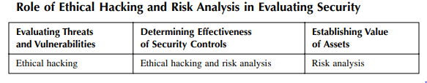
Risk Analysis and Ethical Hacking.

Slide 56
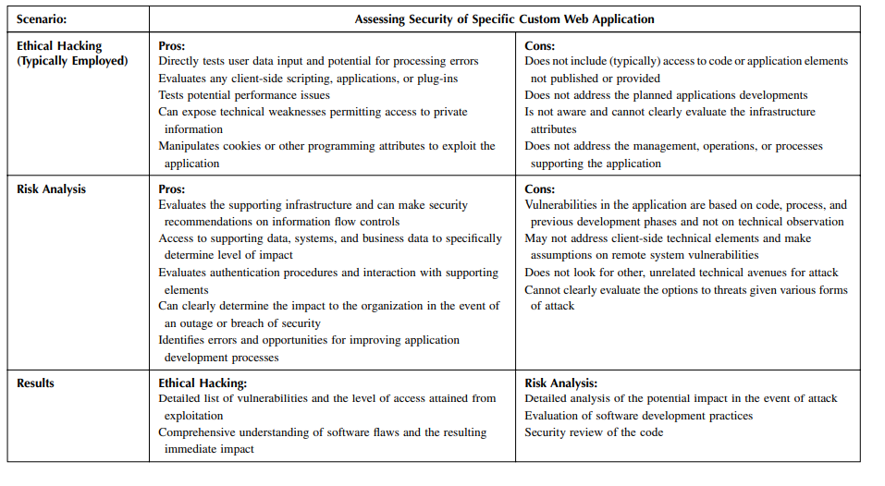
Risk Analysis and Ethical Hacking- cont…

